Slide 1
Introduction to Cybersecurity
Chapter 2
Dr. Mohammed Tawfik

Slide 2
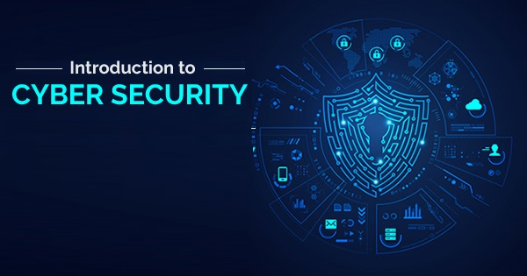
Chapter 2:
Cybersecurity Concepts
Dr. Mohammed Tawfik

Slide 3
Outline
Cyberattack
Cybersecurity Threats
Cybersecurity Vulnerabilities
Hackers
Security Project Team
Securing the Components , Data Ownership
Most common security mistakes
Information Security Responsibilities
Cybersecurity Certificates

Slide 4
Cyberspace of Security?
Each day, there is an increase in the number of threats against our nation's critical infrastructures.
These threats come in the form of computer intrusion (hacking), denial of service attacks, and virus deployment.
CERT- performs emergency cyber security functions and releases annual reports on security incidents.
CERT: Computer Emergency Response Team

Slide 5
Cyber attack
Cyber attack: A malicious attempt, using digital technologies, to cause personal or property loss or damage, and/or steal or alter confidential personal or organizational data.
1-Insider Attacks: Attacks to an organization carried out by someone who is inside that organization either by himself or with connivance of an outsider.
Difficult to counter using technical methods as the insider may have valid credentials to access the system.
2-External attacks: Attacks to an organisation carried out by an external agent.
Requires either valid credentials or the exploitation of some vulnerabilities to gain access to the systems.

Slide 6
Analysis of Cyberattack
•
WHO
– 95% from external agents (hackers)
– 4% from implicated internal employees
– < 1% by Business Partners
– 58% of all data thefts linked to activist groups

Slide 7
Malicious and accidental damage
• Cybersecurity is most concerned with Cyber attacks
• Cyber-accidents: Accidental events that can cause loss or damage to an individual, business or public body.
• Many of the same technologies used to protect against external attack also protect against cyber-accidents.

Slide 8

Cybersecurity Threats
What Is a Cyber Security Threat?
A cyber security threat refers to any possible malicious attack that seeks to unlawfully access data, disrupt digital operations or damage information. Cyber threats can originate from various actors, including corporate spies, hacktivists, terrorist groups, hostile nation-states, criminal organizations, lone hackers and disgruntled employees.
Hacktivism
Hack + Activism = Hacktivism
the use of legal and/or illegal digital tools in pursuit of a political / personal objectives

Slide 9
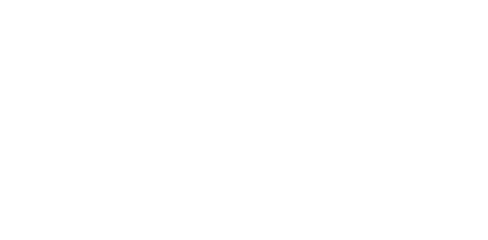
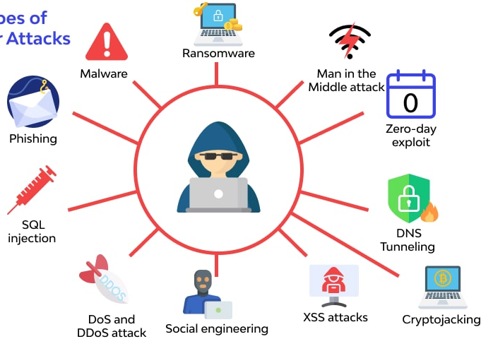
Cybersecurity Threats
1-Malware
2-Phishing
3-SQL Injection
4-Denial of Service
5-Social Engineering
6-XSS attacks
7-Password cracking
8-Identity Fraud /
Identity Theft
9-Zero-day exploit
10-Man in the Middle
11-Ransomware
Identity Fraud/
Identity theft
Password
Cracking

Slide 10
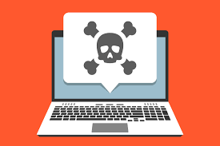
1- Malware
◆ Malware = “Malicious software”
◆ Malware is any kind of unwanted software(malicious) that is installed without your consent(approval) on your computer and other digital devices.
◆ Viruses, Worms, Trojan horses, Bombs, Spyware, Adware, Ransomware are subgroups of malware.
◆ Malware can usually spread itself from one
computer to another either as a virus or as a worm.

Slide 11

To Stop Malware
Download an anti-malware program that also helps prevent infections.
Do not download from unknown sources Activate
Use Network Threat Protection, Firewall, Antivirus.

Slide 12
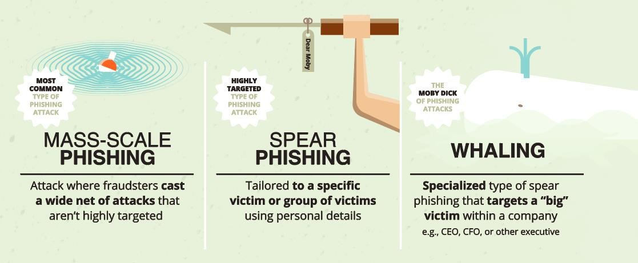
2- Phishing
◆ Phishing refers to the practice of creating fake emails or SMS that appear to come from someone you trust, such as: Bank, Credit Card Company, Popular Websites.
◆ The email/SMS will ask you to “confirm your account details or your vendor’s account details”, and then direct you to a website that looks just like the real website, but whose sole purpose is for steal information.
◆ Of course, if you enter your information, a cybercriminal could use it to steal your identity and possible make fraudulent purchases with your money.

Slide 13
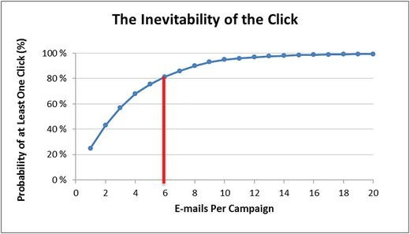
Phishing Statistics
◆ Verizon DBIR 2020: Phishing is the biggest cyber threat for SMBs, accounting for 30% of SMB breaches
◆ KnowBe4: 37.9% of Untrained Users Fail Phishing Tests
◆ 84% of SMBs are targeted by Phishing attacks
◆ A new Phishing site launches every 20 seconds
◆ 74% of all Phishing websites use HTTPS
◆ 94% of Malware is delivered via email

Slide 14
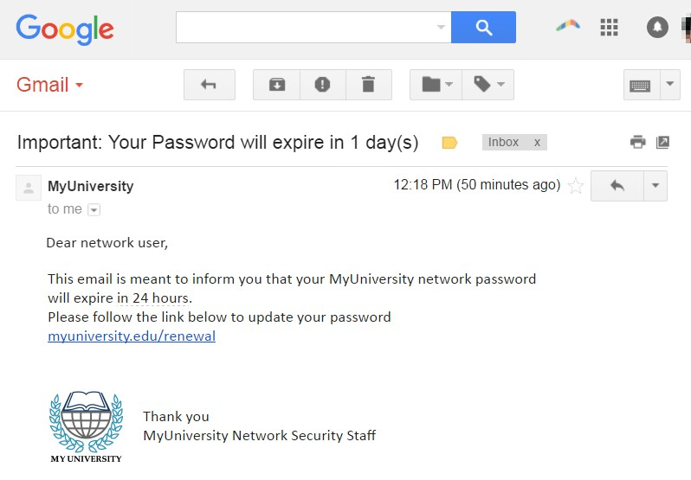
Example of Phishing

Slide 15
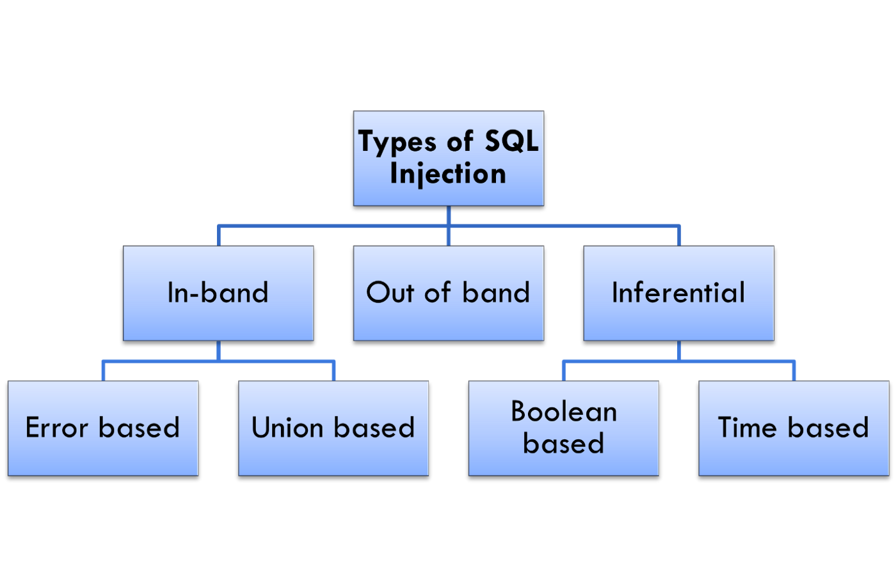
3- SQL injection
SQL injection, is a common attack vector that uses malicious SQL code for backend database manipulation to access information that was not intended to be displayed.
Types of SQL Injection:
In-band SQL Injection.
Out of band SQL Injection.
Inferential SQL Injection.

Slide 16
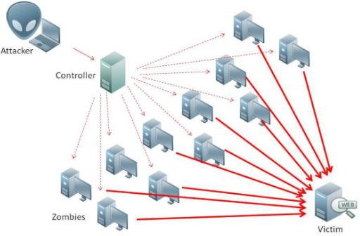

4- Denial Of Service Attack
• Attempt to make a machine or network resource unavailable to its intended users.
• Typically target sites or services hosted on high-profile web servers such as banks, credit card payment gateways, and even root nameservers.

Slide 17
5- Social Engineering
◆ When attempting to steal information or a person’s identity, a hacker will often try to trick you into giving out sensitive information rather than breaking into your computer.
◆ Social Engineering can happen:
◆ Over the phone
◆ By text message
◆ Instant message
◆ Email

Slide 18
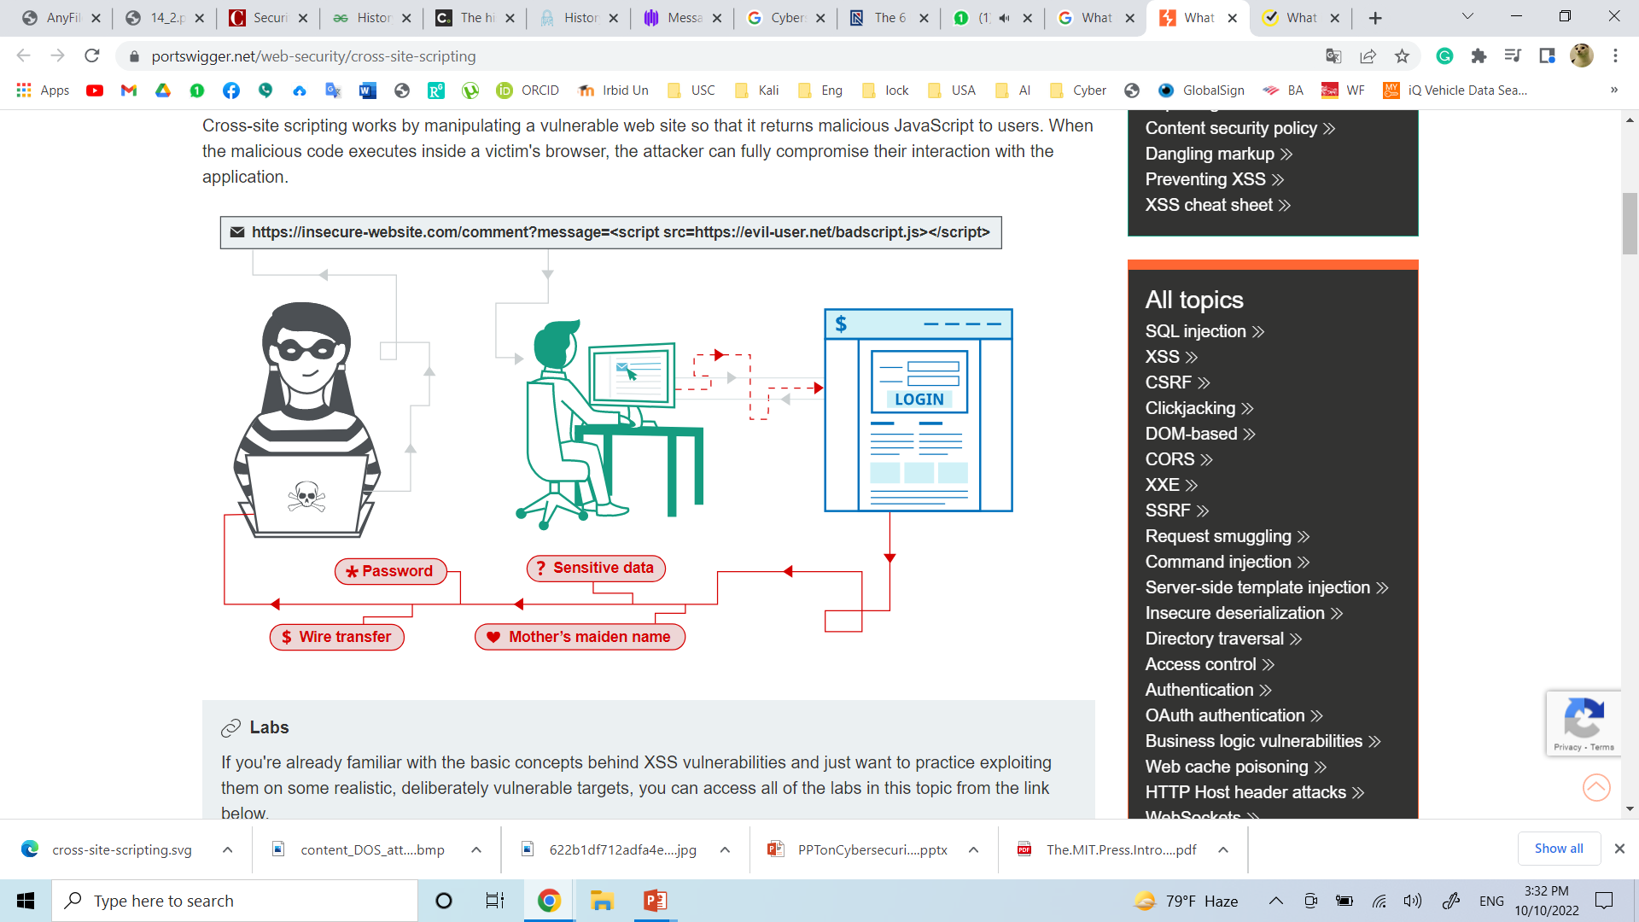
6-Cross Site Scripting (XSS)
◆ XSS is a type of security vulnerability that can be found in some web applications. XSS attacks enable attackers to inject client-side scripts into web pages viewed by other users. A cross-site scripting vulnerability may be used by attackers to bypass access controls such as the same-origin policy.

Slide 19
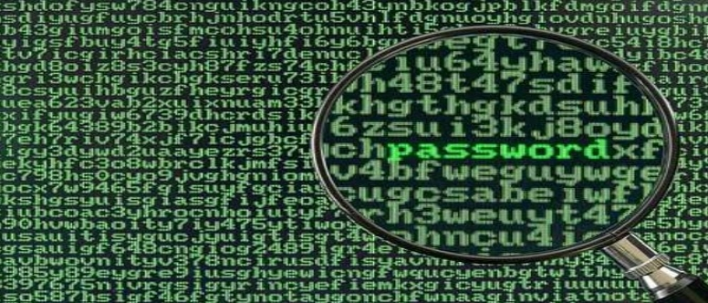
7- Password Cracking
♦ Password Cracking: Password attacks are attacks by hackers that are able to determine passwords or find passwords to different protected electronic areas and social network sites.
♦ To Secure your Password use always Strong password. Never use same password for two different sites.

Slide 20


8- Identity Fraud / Identity Theft
Identity Theft: Stealing someone's identity in which someone pretends to be someone else by assuming that person's identity
◆ Identity Theft
◆ Impersonation by private information
Thief can ‘become’ the victim
◆ Reported incidents rising
◆ Methods of stealing information
◆ Shoulder surfing  Snagging
◆ Dumpster diving  Social engineering
◆ High-tech methods

Slide 21
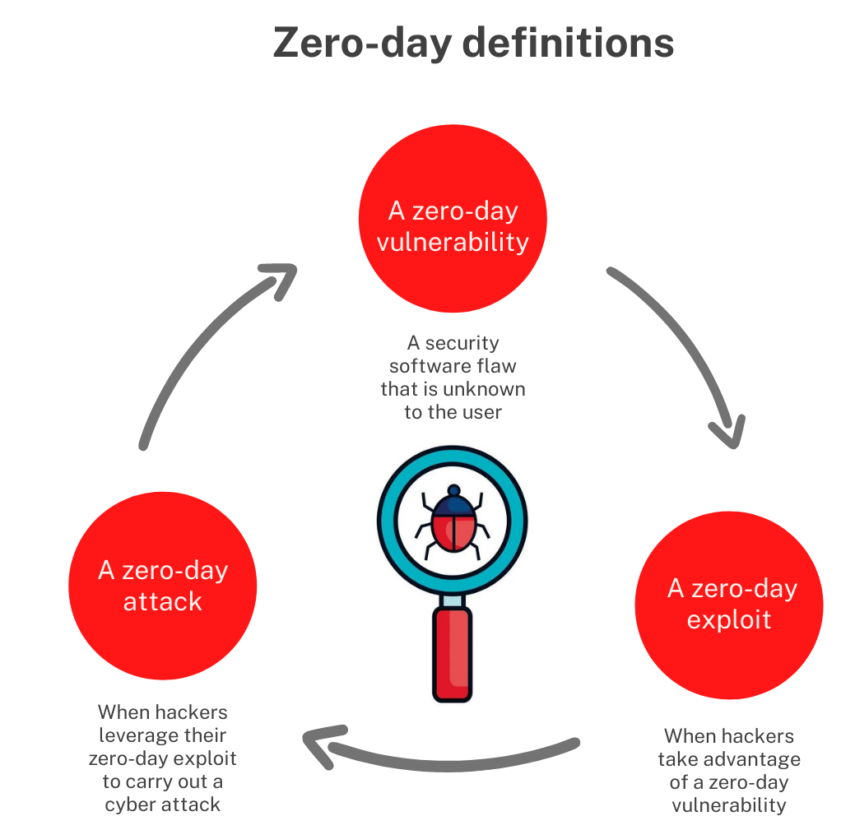
9- Zero-day exploit
”Zero-day" is a broad term that describes recently discovered security vulnerabilities that hackers can use to attack systems. The term "zero-day" refers to the fact that the vendor or developer has only just learned of the flaw – which means they have “zero days” to fix it. A zero-day attack takes place when hackers exploit the flaw before developers have a chance to address it.
A zero-day vulnerability is a software vulnerability discovered by attackers before the vendor has become aware of it. Because the vendors are unaware, no patch exists for zero-day vulnerabilities, making attacks likely to succeed.
A zero-day exploit is the method hackers use to attack systems with a previously unidentified vulnerability.
A zero-day attack is the use of a zero-day exploit to cause damage to or steal data from a system affected by a vulnerability.

Slide 22
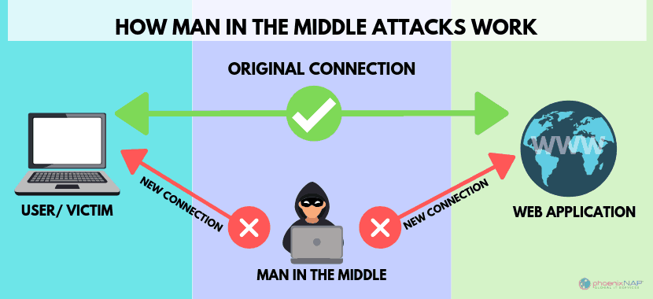
10- A man in the middle (MITM)
♦ A man-in-the-middle (MITM) attack occurs when hackers insert themselves into a two-party transaction. After interrupting the traffic, they can filter and steal data, according to Cisco. MITM attacks often occur when a visitor uses an unsecured public Wi-Fi network. Attackers insert themselves between the visitor and the network, and then use malware to install software and use data maliciously.

Slide 23
Identity Theft
◆ Loss of privacy
◆ Personal information is stored electronically
Purchases are stored in a database
Data is sold to other companies
Public records on the Internet
◆ Internet use is monitored and logged
◆ None of these techniques are illegal

Slide 24
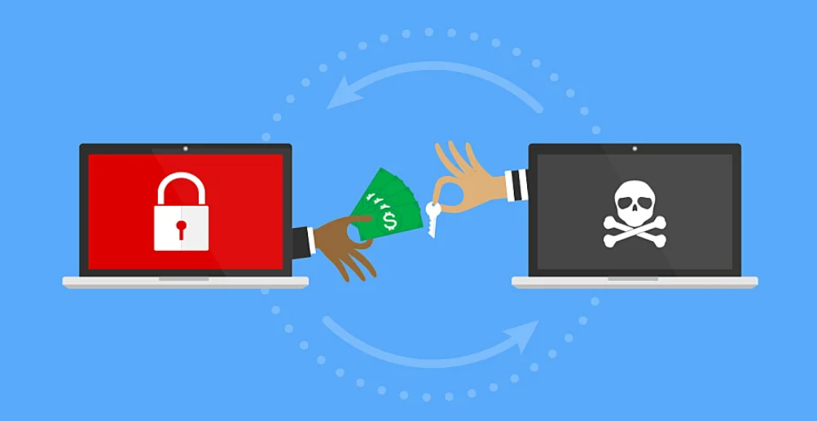
11- Ransomware
Ransomware is a type of malware that prevents or limits users from accessing their system, either by locking the system's screen or by locking the users' files until a ransom is paid.

Slide 25
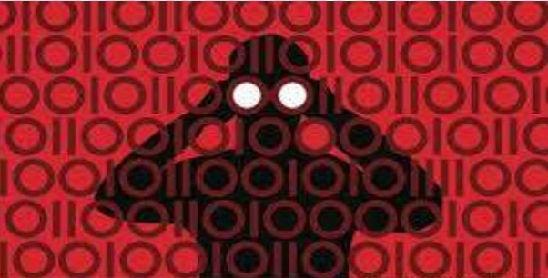
Hackers
♦
In common, a hacker is a person who breaks into computers, usually by gaining access to administrative
controls.

Slide 26
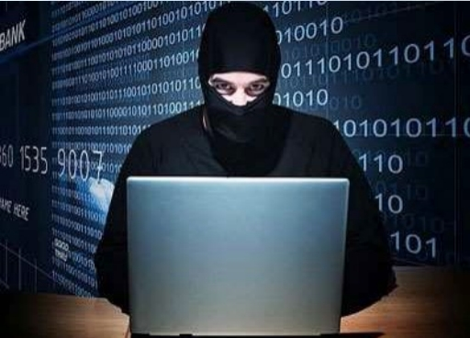
Types of Hacker
♦
White Hat Hacker
♦
Grey Hat Hacker
♦
Black Hat Hacker

Slide 27
Types of Hacker
Hackers can be divided into three groups:
1-White hats
White Hats are the good guys, the ethical hackers who use their hacking skills for defensive purposes. White-hat hackers are usually security professionals with knowledge of hacking and the hacker toolset and who use this knowledge to locate weaknesses and implement countermeasures.

Slide 28
Types of Hacker
2- Black hats
Black hats are the bad guys: the malicious hackers or
crackers who use their skills for illegal or malicious purposes. They break into or otherwise violate the system integrity of remote machines, with malicious intent. Having gained unauthorized access, black-hat hackers destroy vital data, deny legitimate users service, and basically cause problems for their targets. Black-hat hackers and crackers can easily be differentiated from white-hat hackers because their actions are malicious.

Slide 29
Types of Hacker
3- Grey hats
Grey hats are hackers who may work offensively or defensively, depending on the situation. This is the dividing line between hacker and cracker. Both are powerful forces on the Internet, and both will remain permanently. And some individuals qualify for both categories. The existence of such individuals further clouds the division between these two groups of people.

Slide 30

How To prevent hacking
♦
It may be impossible to prevent computer hacking, however effective
security controls including strong passwords, and the use of firewalls can helps.

Slide 31
Malicious and accidental damage
Cybersecurity is most concerned with Cyber attacks
Cyber-accidents: Accidental events that can cause loss or damage to an individual, business or public body.
Many of the same technologies used to protect against external attack also protect against cyber-accidents.

Slide 32
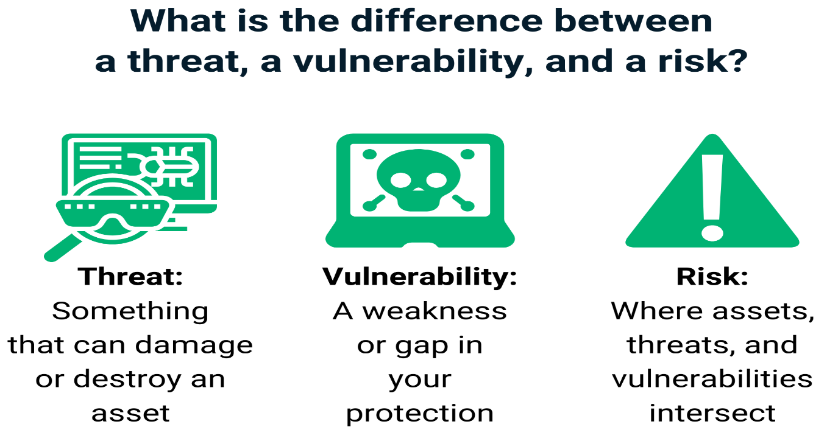
Cybersecurity Vulnerabilities
A vulnerability in cybersecurity is a weakness in a host or system, such as a missed software update or system misconfiguration, that can be exploited by cybercriminals to compromise an IT resource and advance the attack path.
A vulnerability is a weakness that can be exploited by a malicious actor. For example, unpatched software or overly permissive accounts can provide a gateway for cybercriminals to access the network and gain a foothold within the IT environment.
A risk is what happens when a cyber threat exploits a vulnerability. It represents the damage that could be caused to the organization in the event of a cyberattack.

Slide 33
Types of Vulnerabilities
Network Vulnerabilities. These are issues with a network’s hardware or software that expose it to possible intrusion by an outside party. Examples include insecure Wi-Fi access points and poorly-configured firewalls.
Operating System Vulnerabilities. These are vulnerabilities within a particular operating system that hackers may exploit to gain access to an asset the OS is installed on—or to cause damage. Examples include default superuser accounts that may exist in some OS installs and hidden backdoor programs.
Human Vulnerabilities. The weakest link in many cybersecurity architectures is the human element. User errors can easily expose sensitive data, create exploitable access points for attackers, or disrupt systems.
Process Vulnerabilities. Some vulnerabilities can be created by specific process controls (or a lack thereof). One example would be the use of weak passwords (which may also fall under human vulnerabilities).

Slide 34
Security Project Team
A number of individuals who are experienced in one or multiple requirements of both the technical and non-technical areas:
The team leader
Security policy developers
Risk assessment specialists
Security professionals
Systems administrators
End users

Slide 35
Senior Management
Chief Information Officer (CIO)
the senior technology officer
primarily responsible for advising the senior executive(s) for strategic planning
Chief Information Security Officer(CISO)
responsible for the assessment, management, and implementation of securing the information in the organization
may also be referred to as the Manager for Security, the Security Administrator, or a similar title

Slide 36
Securing the Components
The computer can be either or both the subject of an attack and/or the object of an attack
When a computer is
the subject of an attack, it is used as an active tool to conduct the attack
the object of an attack, it is the entity being attacked

Slide 37
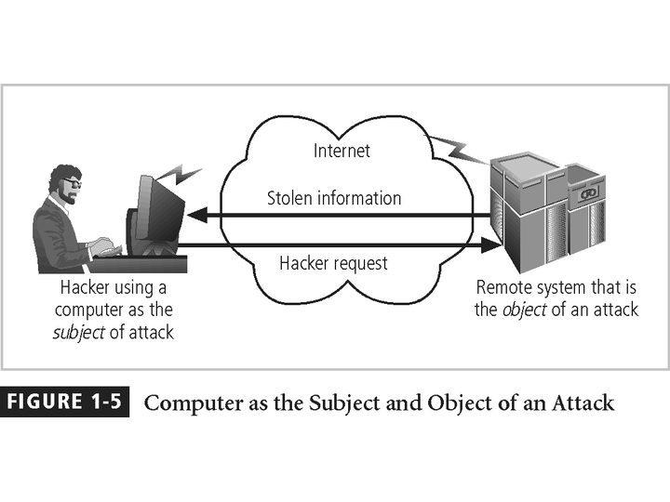
Figure 1-5 – Subject and Object of Attack

Slide 38
Data Ownership
Data Owner - responsible for the security and use of a particular set of information
Data Custodian - responsible for the storage, maintenance, and protection of the information.
Data Users - the end systems users who work with the information to perform their daily jobs supporting the mission of the organization.

Slide 39
Most common security mistakes
•
Poor password management
•
Not locking the computer while unattended
•
Opening email attachments from unknown addressees Not running anti-virus programs
•
•
Sharing information (and machines)
•
Not reporting security violations
•
Unattended Paper Documents
•
Unprotected Electronic Data (while at rest and in motion).E.g: Emails, USB’s, CD’s, etc..
•
Improper Information Handling
•
Passing of information over Phone.

Slide 40
Information Security Responsibilities
Engage Information Security teams to support the line of business, enabling secure solutions for new processes and technology.
Work with Information Security teams to drive line of business-specific information security metrics reporting
Support Regional Information Security teams in mitigating security risks from Internal Audit report findings
Follow business continuity plans given by bank, in case of any disaster/ emergency.
Report Security Violations and security incidents
Adhere to Bank’s Information Security Policy and guidelines
Maintain and update Asset register of your office/dept
Extend support to Security team during Risk Assessment and Business Impact Analysis of your office/dept

Slide 41
Information Security Responsibilities
Implement and act in accordance with the organization’s information security policies and procedures
Protect assets from unauthorized access, disclosure, modification, destruction, or interference
Execute defined security processes or activities
Report security events, potential events, or other security risks by following approved processes
Do not use systems or access information without authorization. Adheres to controls put in place to protect assets

Slide 42
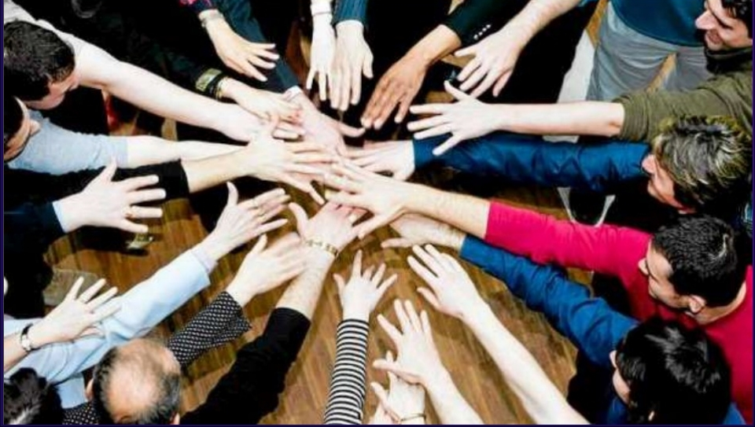
Cyber Security Is Everyone’s Responsibility
Robert Statica – Cybersecurity

Slide 43
How to Become a Cybersecurity Specialist
Cybersecurity specialists must be able to respond to threats as soon as they occur. This means that the working hours can be somewhat unconventional. Cybersecurity specialists also analyze policies, trends, and intelligence to understand how cyber criminals think. Here is good advice for becoming a cybersecurity specialist:
Study: Learn the basics by completing courses in IT. Be a life-long learner. Cybersecurity is an ever-changing field, and cybersecurity specialists must keep up.
Pursue Certifications: Industry and company sponsored certifications from organizations such as Microsoft and Cisco prove that one possesses the knowledge needed to seek employment as a cybersecurity specialist.
Pursue Internships: Seeking out a security internship as a student can lead to opportunities down the road.
Join Professional Organizations: Join computer security organizations, attend meetings and conferences, and join forums and blogs to gain knowledge from the experts.

Slide 44
Creating More Experts Cybersecurity Certifications
Industry Certifications
In a world of cybersecurity threats, there is a great need for skilled and knowledgeable information security professionals. The IT industry established standards for cybersecurity specialists to obtain professional certifications that provide proof of skills, and knowledge level.
CompTIA Security+ - Security+ is a CompTIA-sponsored testing program that certifies the competency of IT administrators in information assurance.
EC-Council Certified Ethical Hacker (CEH) – CEH is an intermediate-level certification asserts that cybersecurity specialists holding this credential possess the skills and knowledge for various hacking practices.
SANS GIAC Security Essentials (GSEC) - The SANS GIAC program offers a number of additional certifications in the fields of security administration, forensics, and auditing.
Cisco Certified Network Associate Security (CCNA Security)
Certified Information Systems Security Professional (CISSP)
Certified Information Security Manager (CISM)
Company Sponsored Certifications

Slide 45
Thanks you

